Slide 2
The Writing Team
Kathy Kolasa, PhD, RDN, LDN
Professor Emeritus
Brody School of Medicine,
East Carolina University
Sheree Vodicka, MPH, RDN, LDN
Chief Executive Officer
NC Alliance of YMCA’s
Dave Gardner, DA
Worksite Wellness and Early Care and Education Coordinator
NC Division of Public Health
Cathy Thomas, MAEd
Branch Manager
NC Division of Public Health
Melissa Rockett, MPA
Built Environment Coordinator
NC Division of Public Health
Catherine Hill, MS, RDN, LDN
Healthy Eating and Communications Coordinator
NC Division of Public Health
Carolyn Dunn, PhD, RDN, LDN
William Neal Reynolds Distinguished Professor and Dept. Head
NC State University
Jenni Albright, MPH, RDN, LDN
Eat Smart, Move More Coordinator
First-Line Reviewers
Tekeela Greeen, PhD, MPH, CHES
Consultant
Diane Beth, MS, RDN, LDN
Nutrition Program Consultant
NC Division of Public Health

Slide 3
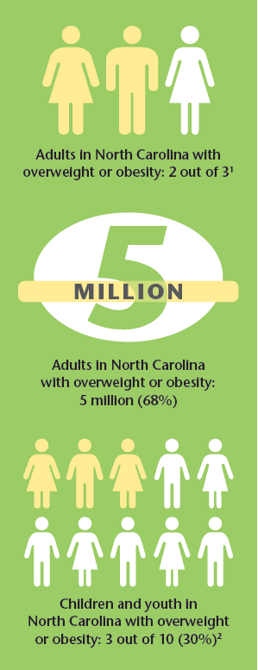

Slide 4
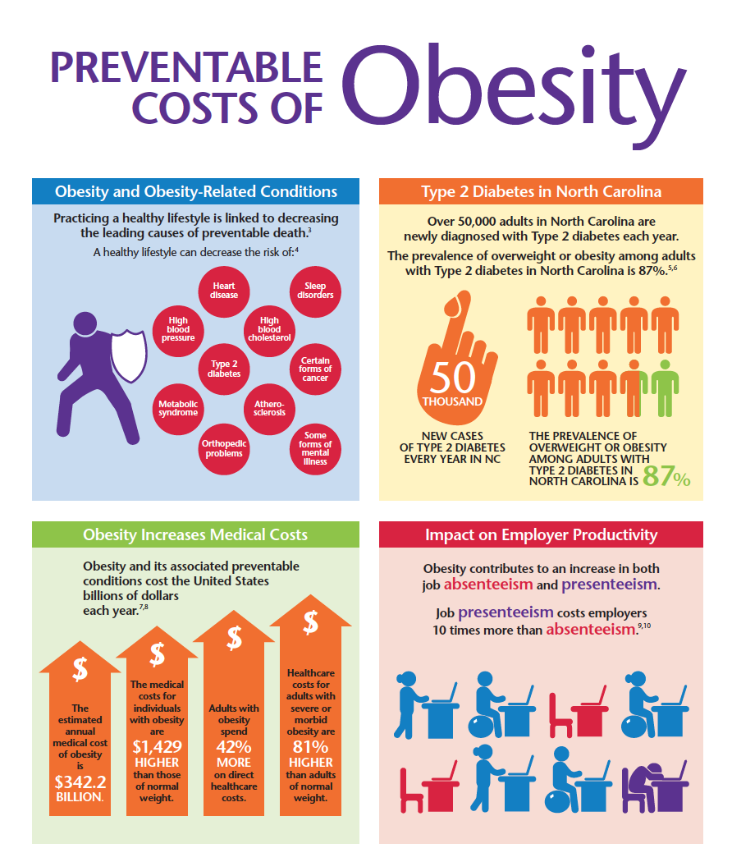

Slide 5
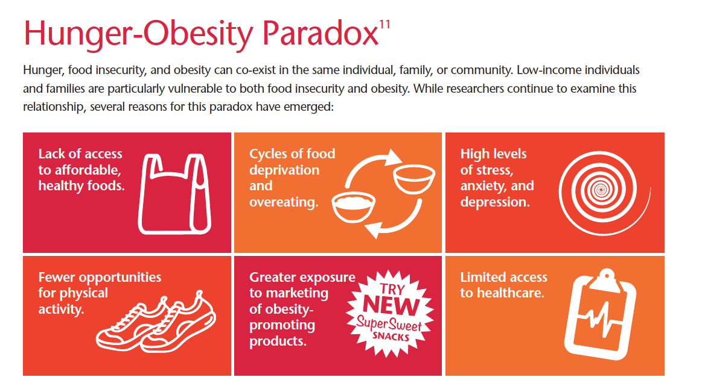

Slide 7
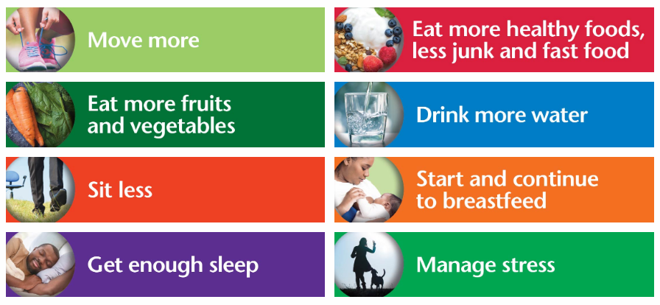

Slide 8
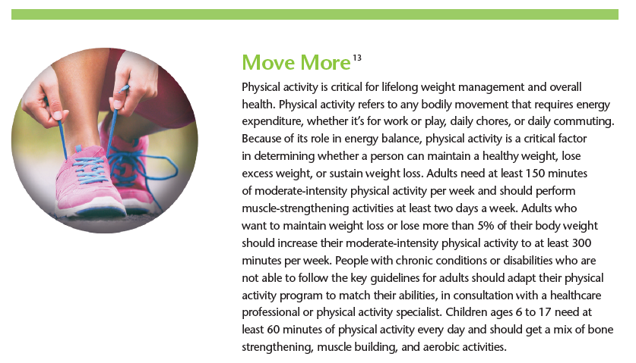

Slide 9
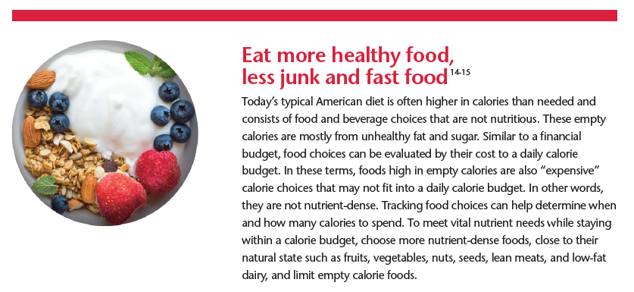

Slide 10
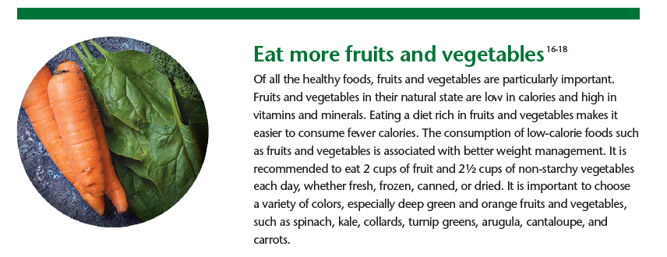

Slide 12
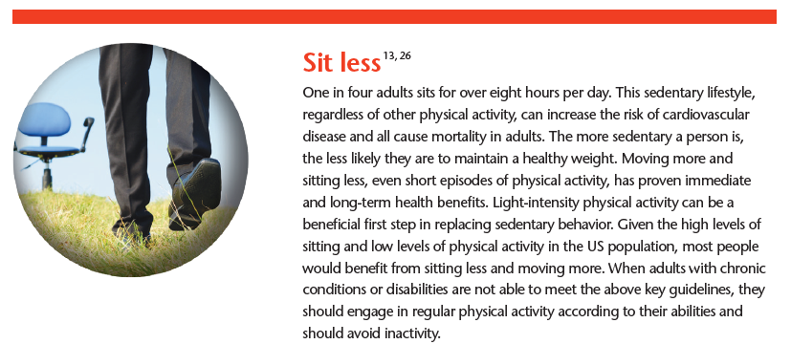

Slide 13
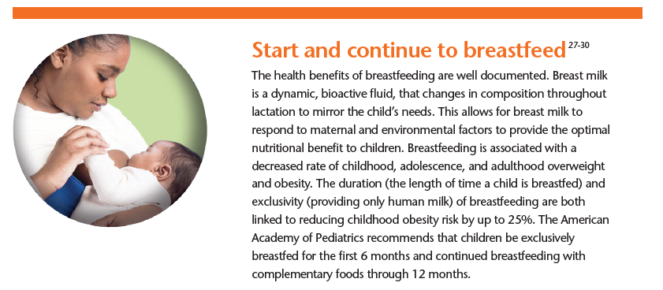

Slide 14
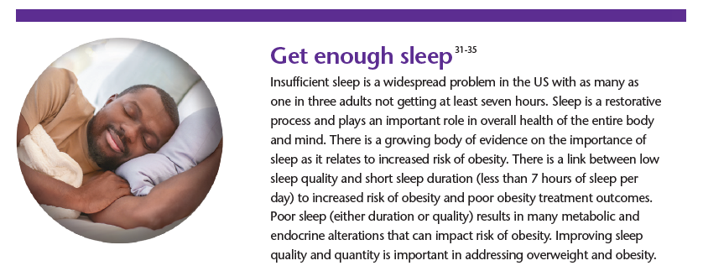

Slide 15
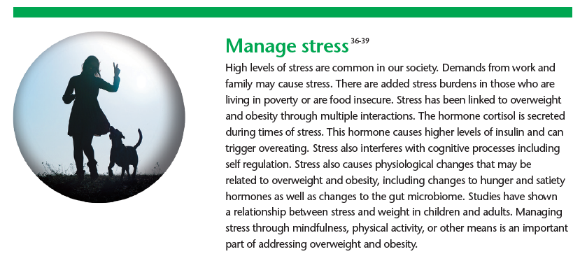

Slide 16
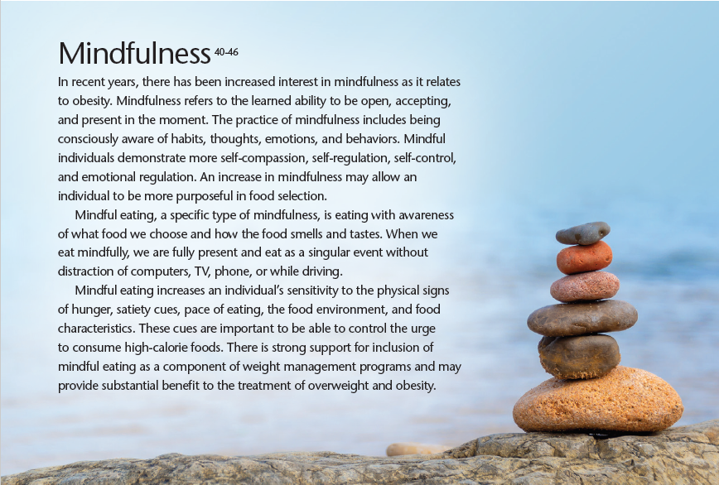

Slide 17
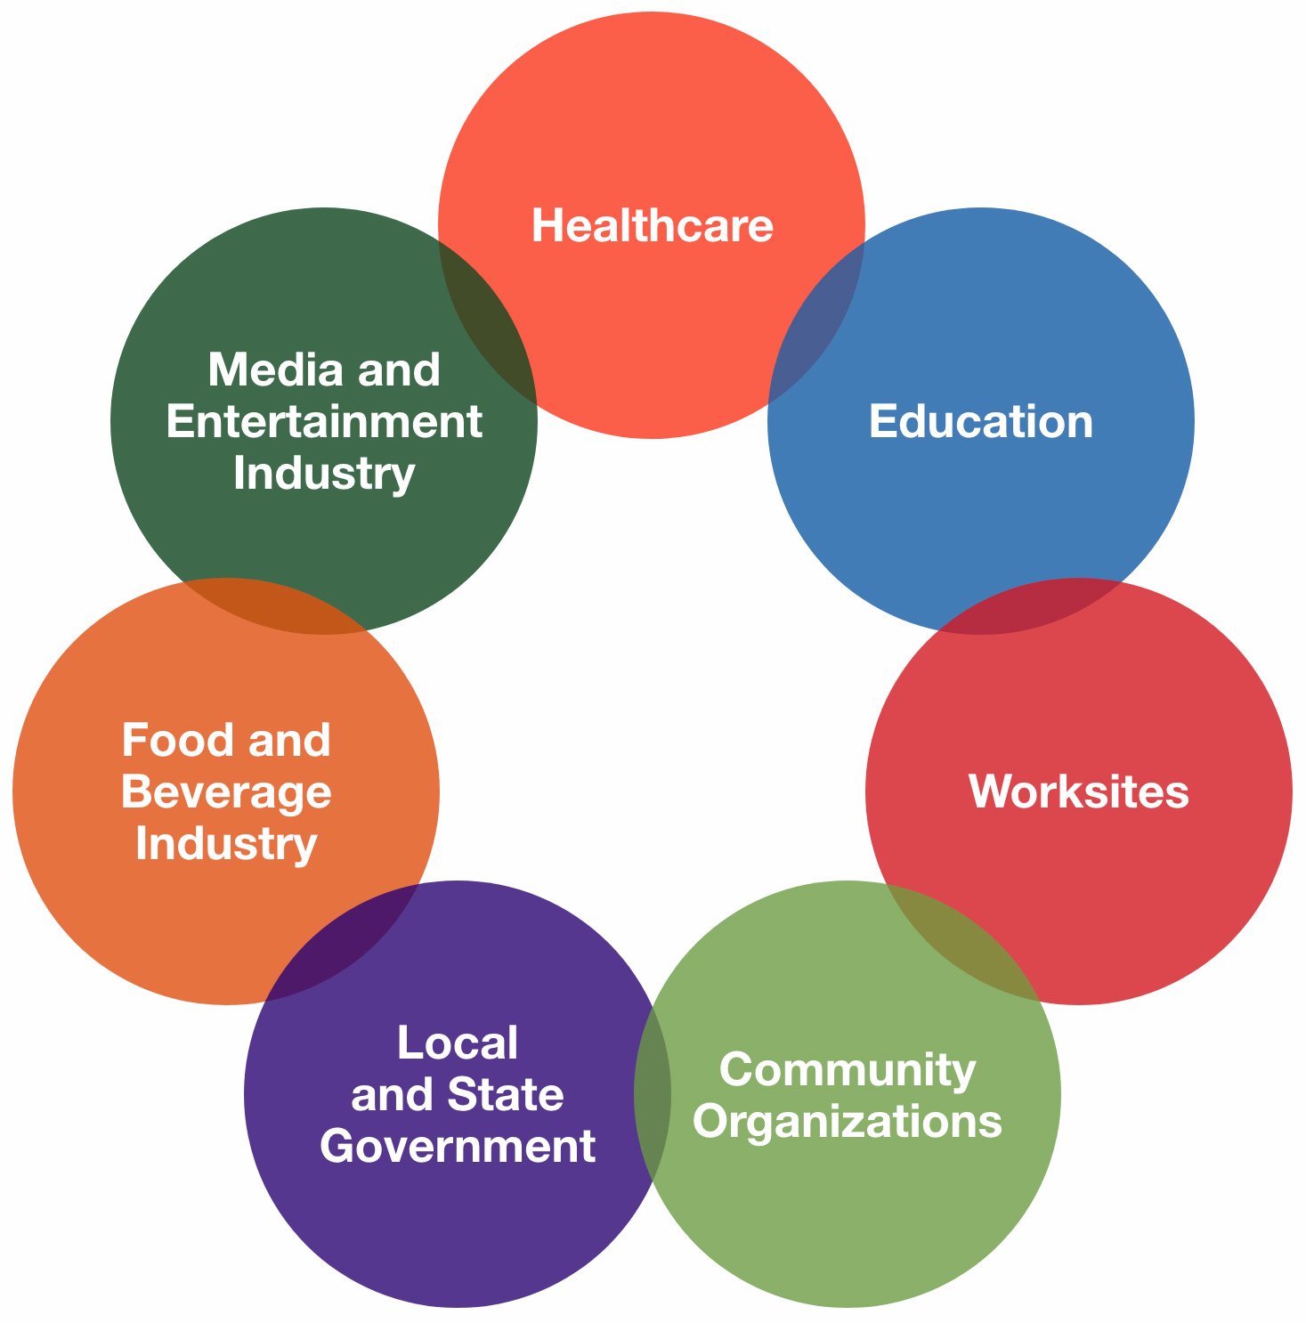

Slide 20
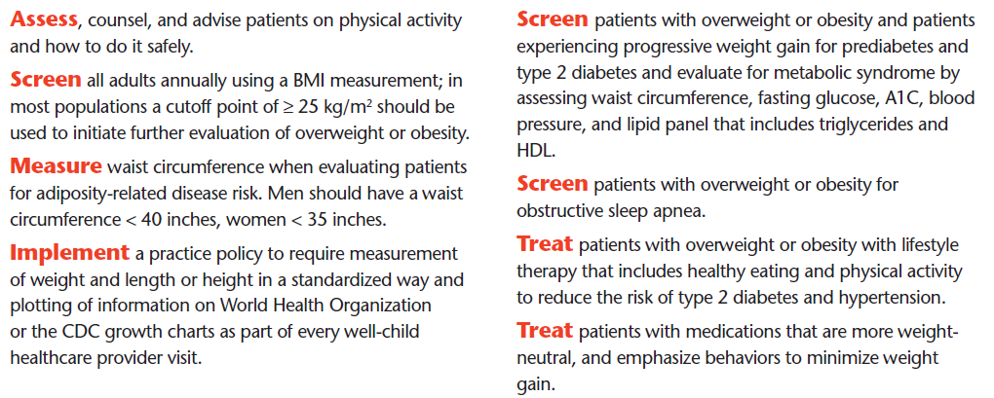
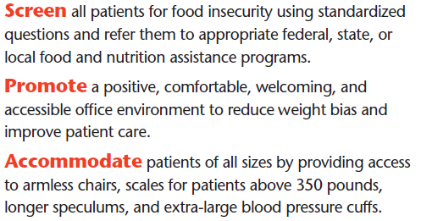
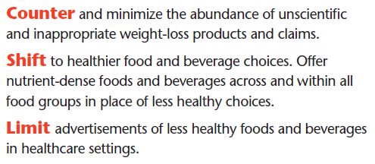

Slide 21
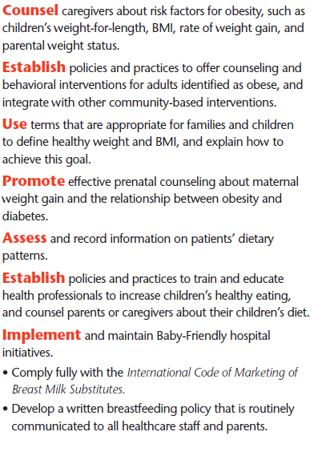
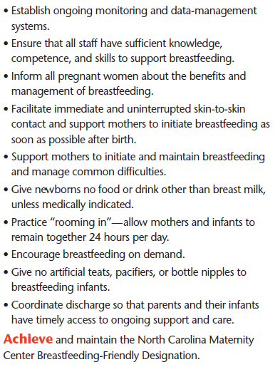

Slide 22
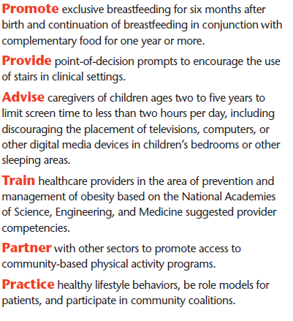

Slide 23
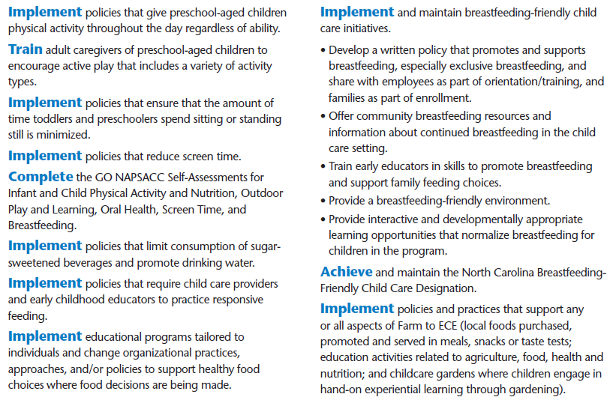

Slide 24
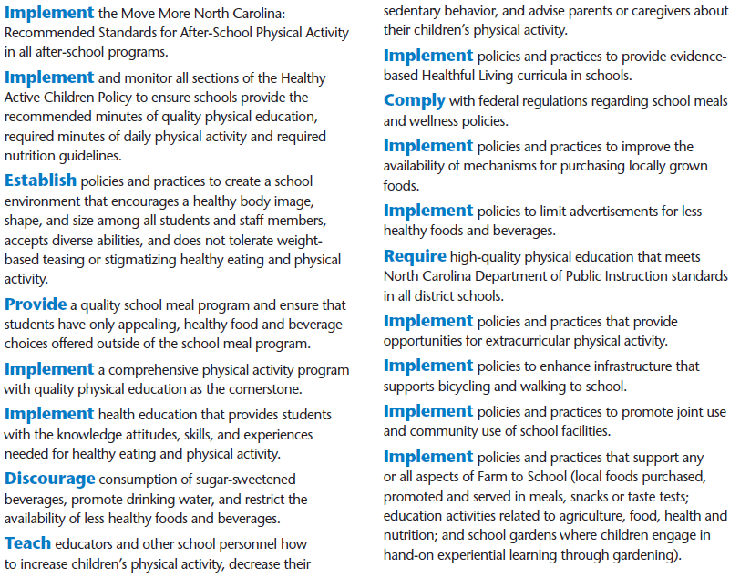

Slide 25
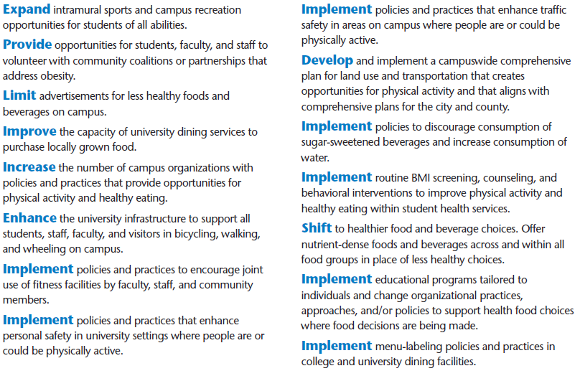

Slide 26
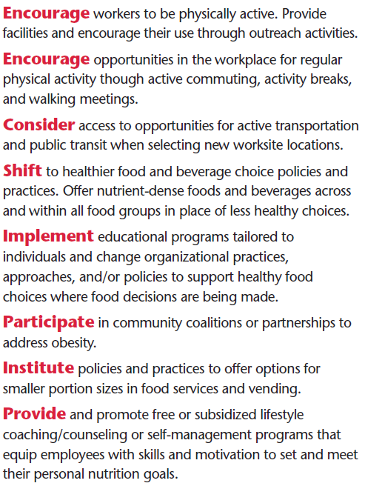
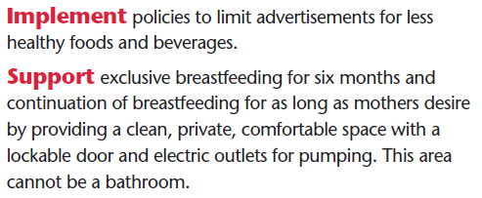
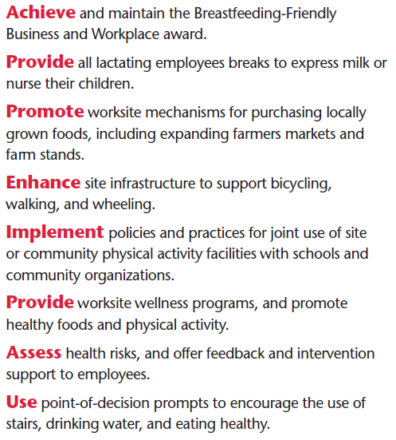

Slide 27
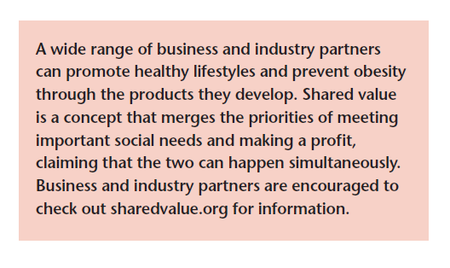

Slide 28
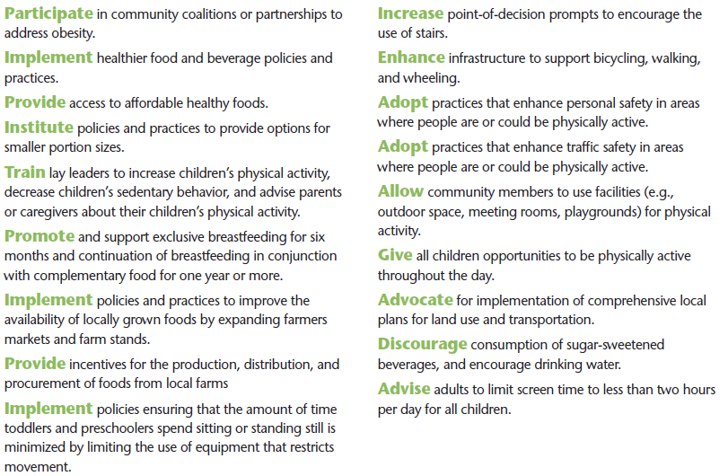

Slide 30
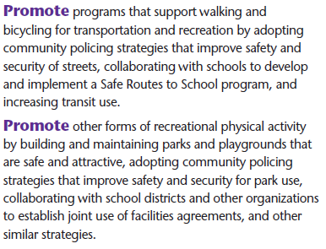
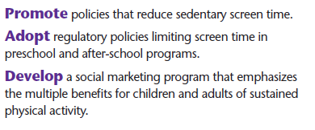
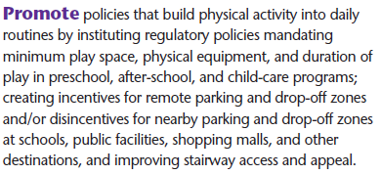

Slide 31
