Slide 1
WELCOME !
Food Security:
Pandemic and Beyond
MEET OUR PANELISTS

Slide 2
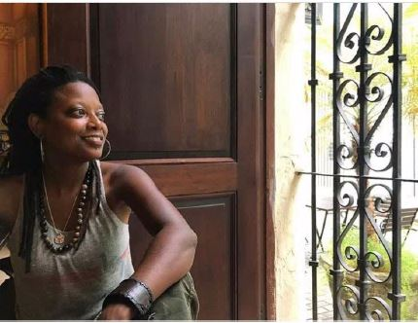
Shorlette Ammons is a North Carolina native and former children’s librarian with a Masters of Library Science from NC Central University. She is currently serving as an Equity in Food Systems Associate with the Center for Environmental Farming Systems at NC State University.
She is part of the CEFS Community Food Strategies team, which supports and uplifts the efforts of food councils around the state. She leads the CORE (Committee on Racial Equity) team where she coordinates and facilitates racial equity trainings and develops curriculum and strategic tools to address food insecurity and other food systems disparities through the lens of structural racism.
Shorlette Ammons
Equity in Food Systems Associate
Center for Environmental Farming Systems (CEFS)

Slide 3
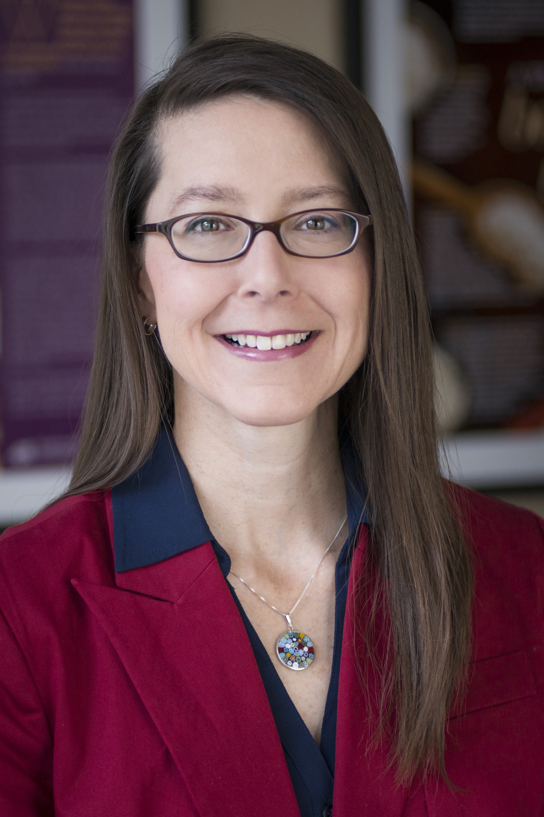
Tracey coordinates nutrition communications and outreach, develops educational materials and resources, promotes healthy school environments, supports farm to school initiatives, and provides professional development for School Nutrition personnel, educators and others working with school-age children and their families.
Bates is currently co-chair for the Farm to School Coalition of North Carolina and serves on the NC Jr. Chef Competition Committee, Whole Child NC interagency committee and the advisory committee for the NC FARMS for NC Kids Coalition.
Tracey Bates, MPH, RDN, LDN, FAND
School Nutrition Program Specialist
School Nutrition Division with the
NC Department of Public Instruction

Slide 4
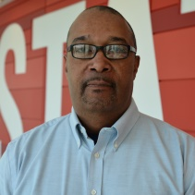
Dr. Kwesi Brookins partners primarily with local Black communities to support their research and advocacy needs.
He serves on the board of the Fertile Ground Food Cooperative, a multi-stakeholder owned grocery store and community gathering space whose mission is to increase access to healthy/affordable food and to serve as a community/cultural center in Southeast Raleigh.
The Fertile Ground Food Cooperative is scheduled to open in 2022.
Kwesi Brookins, Ph.D.
Board Member, Fertile Ground Food Cooperative
Professor and Director, Center for Family and Community Engagement at NC State University

Slide 5
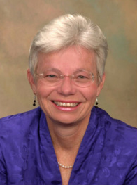
Dr. Kolasa worked with ECU Physicians to research and develop an
emergency food bag tailored for pregnant women who screen food insecure.
The MOTHeRS Project is a pilot funded by United Health Foundation.
All documents from the MOTHeRS Project are available to professionals to use/adapt for their programs. All of the documents have been uploaded to ECU’s repository called The ScholarShip: https://thescholarship.ecu.edu/
Kathryn M Kolasa PhD, RDN, LDN, Professor Emeritus
Representing The MOTHeRS Project, ECU Physicians,
Brody School of Medicine at East Carolina University
Dr. Kolasa has been involved in applied nutrition programs in eastern North Carolina since 1983.
She is one of the authors of the ESMM North Carolinas Plan to Address Overweight and Obesity.

Slide 6
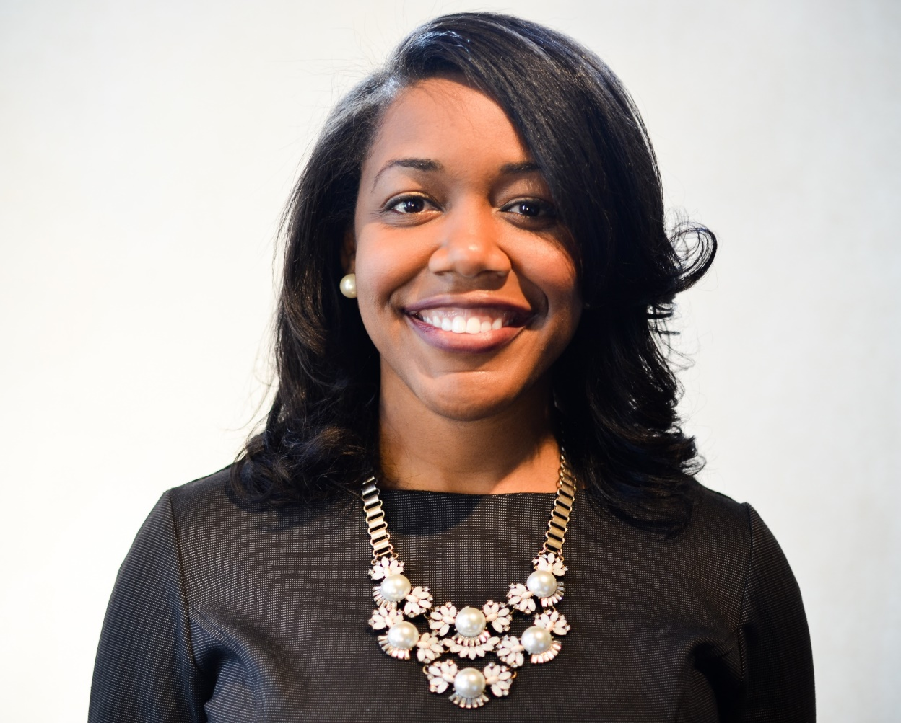
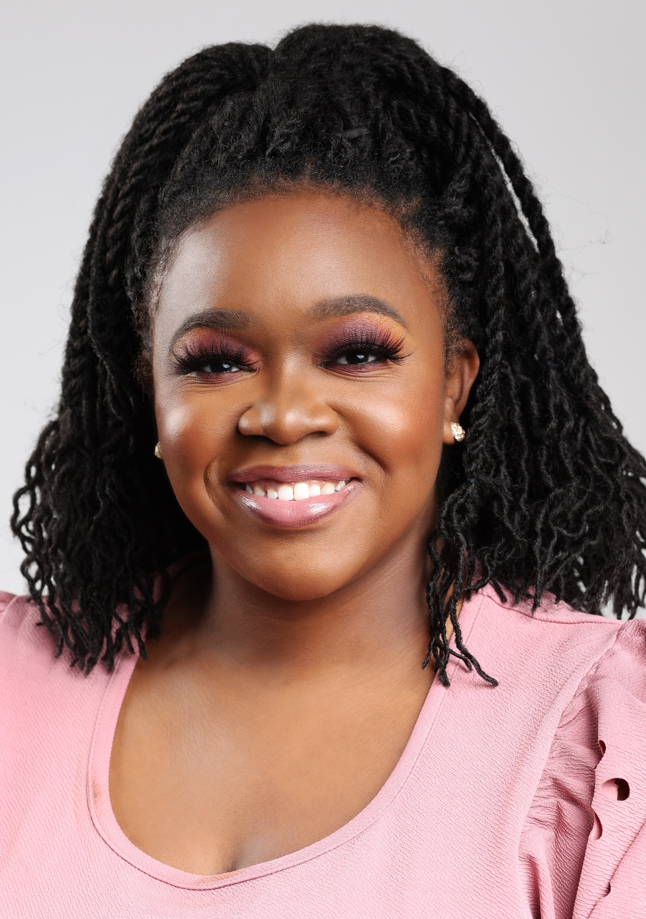
The Farmers B.A.G is setting a new standard for how to support farmers of color and engage youth in positive agricultural experiences. Our commitment to healing our people, our land, and creating brave spaces for people of color to thrive in the profession of agriculture is unwavering.
As co-owners of The Farmers B.A.G, we specialize in experiences that transform the heart and mind with connection to the earth.
Brielle Wright
Owner, The Farmers B.A.G.
Michelle Wright
Owner, The Farmers B.A.G.
Brielle grew up in the small agricultural town of Clarkton, NC surrounded by farming and education. She did her best to escape both, only to end up with degrees in agribusiness and ag education. She has worked in corporate, education, and government and has experience in program development, process improvement, and business management.
Michelle has a background in public health, psychology, and racial justice. She is passionate about decreasing disparities in access to healthy foods, centering racial justice in health, and building healthy relationships with community by practicing relational power dynamics.

Slide 7
Eat Smart, Move More NC Updates
Next Eat Smart, Move More Partner Meeting
Thursday, December 2
1:00-2:30 pm
Topic: Move More and Sit Less

