Slide 1

WELCOME !
As you enter today’s meeting, use the chat box to tell us:
Your organization/community.
Something you are looking forward to in the new year.
Notes:
Joanne:
Mentions that we will begin recording the meeting when we start the presentation from our guest speaker.
Welcomes partners as they connect to the meeting.
Poses intro questions and encourages partners to reply in the chat box “To Everyone” so everyone can see the responses.
Your organization or community.
Something you are looking forward to in the new year.
Acknowledges partners’ chat responses as they come in.
Introduces each Executive Committee member and asks them to “wave” (on screen).
Jenni:
CHATS: Welcome to the Eat Smart, Move More NC partners meeting!
CHATS: Chat “To Everyone” – Tell us your community and something you are looking forward to in the new year.

Slide 2
Meeting Agenda
1:00 pm Welcome, Introductions
1:05 pm Sleep as a Core Behavior for Optimal Health
Dr. David N. Collier, MD, PhD, FAAP
East Carolina University
1:30 pm Networking and Collaborative Learning: Sleep and Other
Core Behaviors in North Carolina’s Plan to Address Overweight and Obesity
Breakout room discussions
1:50 pm Eat Smart, Move More NC Updates
2:00 pm Close
Notes:
Joanne:
Here you see the agenda for our meeting today, and Jenni is pasting it into the chat box now in case you’d like to view your own copy.
The Executive Committee has planned activities that we hope will provide a mix of learning, sharing and networking.
To start, we are pleased and grateful to have Dr. David Collier joining us to help us learn more about sleep as a core behavior for health and wellness.
We’ll then have time for you to engage in smaller breakout discussions to share about your work and interests around sleep and other core behaviors in our state plan.
We’ll wrap-up today’s meeting by providing updates about our Eat Smart, Move More NC movement as we move into the new year.
Jenni:
UPLOADS meeting agenda into the chat box.

Slide 3

Sleep as a Core Behavior for Optimal Health
Dr. David N. Collier, MD, PhD, FAAP
East Carolina University
Notes:
Joanne:
Introduces Dr. Collier.
Professor of Pediatrics and Health Disparities and Director, Pediatric Healthy Weight Research and Treatment Center at East Carolina University.
Associate Director Integrative Health Sciences Facility Core NCSU Center for Human Health and the Environment.
Recently elected as the Soil & Water Conservation District Supervisor for Pitt County.
Jenni:

Slide 4
Sleep Health
”Sleep, like nutrition and physical activity, is a critical determinant of health and well being.”*
David Collier, M.D., Ph.D.
Brody School of Medicine
ESMM 12/9/2020
*https://www.healthypeople.gov/2020/topics-objectives/topic/sleep-health
Golem DL et al. An integrative review of sleep for nutrition professionals. Adv Nutr 2014;5:742-759.
Notes:
Recommend article by Golem et al – a lot of the material contained in this presentation is drawn form this review.

Slide 5
Sleep is…..”a recurring, reversible neurobehavioral state of perceptual dis-engagement from and unresponsiveness to the environment… typically accompanied (in humans) by postural recumbence, behavioral quiescence and closed eyes.”
Physiological changes in sleep
Release melatonin from pineal gland
Alterations in brain-wave activity
Decreased: heart rate blood pressure Respiration O₂ saturation body temp energy expenditure
Type Sleep | Stage | Percent | Comments
Non-REM | Stage 1 | 2-5% | Shallow
 | Stage 2 | 45-55%
 | Stage 3 Stage 4 | 15-28% | Slow Wave Sleep (SWS) Deep, restorative
REM | REM | 25% | Rapid Eye Movement Dreams, memory consolidation
Cycle 1 | Cycle 2 | Cycle 3 | Cycle 4 ………. 5-7 cycles
1,2,3,4,2,3,4,2;REM | 1,2,3,4,3,2;REM | 1,2,3,4,3,2;REM | 1,2,3,4,3,2;REM
Golem DL et al. An integrative review of sleep for nutrition professionals. Adv Nutr 2014;5:742-759.

Slide 6

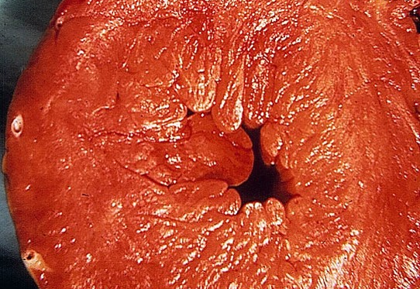

Chronic Sleep Insufficiency and Sleep Disorders Are Associated With Increased Risk Of:
Heart disease
Hypertension
Pulmonary hypertension
Obesity
Type 2 diabetes mellitus
All-cause mortality
https://www.healthypeople.gov/2020/topics-objectives/topic/sleep-health

Slide 7



Adequate Sleep Is Necessary To:
Fight off infections
Support normal glucose metabolism and prevent type 2 diabetes mellitus
Perform well in school
Work effectively and safely
Promote mental well-being & health
  Health …. “a state of complete physical, mental and social well-being and not merely the absence of disease or infirmity” (WHO 1948)
https://www.healthypeople.gov/2020/topics-objectives/topic/sleep-health

Slide 8

What is the recommended amount of sleep?
American Academy of Sleep Medicine and Sleep Research society 2015 Consensus Panel
  Panel 16 experts, 12-month process
  Reviewed 5,314 articles
  Oxford grading system, RAND Appropriateness
Conclusions:
  ≥ 7 hours sleep per night on regular basis are required for optimal health among adults 18-60 yrs.
    Weight gain, obesity, diabetes, hypertension, heart disease, stroke, depression, death.
    Impaired immune function, increased pain, impaired performance, increased errors, accidents
  > 9 hours sleep per night on regular basis may be appropriate for young adults, those recovering from sleep debt or individuals with disease.
    Uncertain if > 9 hr. in others is associated with risk
*Sleep recommendations for children/adolescents
  Infants (4-12 mo.) 12-16 h.
  Toddlers (1-2 y.) 11-14 h.
  Preschoolers (3-5 y.) 11-13 h.
  Children (6-12 y.) 9-12 h.
  Teenagers (13-18 y) 8-10 h.
  Regularly sleeping more than recommended amounts may be associated with adverse health outcomes
Consensus Conference Panel. Sleep 2015:38(6):843-844 and *J Clin Sleep Med 2106;6:785-786.

Slide 9

Age-adjusted Percentage Reporting Chronic Health Conditions By Sleep Duration—Behavioral Risk Factor Surveillance System, United States, 2014
 | Short sleep (<7 hours) |  | Sufficient sleep (≥7 hours)
Chronic condition | % | 95% CI | % | 95% CI
Heart attack | 4.8 | (4.6–5.0) | 3.4 | (3.3–3.5)
Coronary heart disease | 4.7 | (4.5–4.9) | 3.4 | (3.3–3.5)
Stroke | 3.6 | (3.4–3.8) | 2.4 | (2.3–2.5)
Asthma | 16.5 | (16.1–16.9) | 11.8 | (11.5–12.0)
COPD (chronic obstructive pulmonary disease) | 8.6 | (8.3–8.9) | 4.7 | (4.6–4.8)
Cancer | 10.2 | (10.0–10.5) | 9.8 | (9.7–10.0)
Arthritis | 28.8 | (28.4–29.2) | 20.5 | (20.2–20.7)
Depression | 22.9 | (22.5–23.3) | 14.6 | (14.3–14.8)
Chronic kidney disease | 3.3 | (3.1–3.5) | 2.2 | (2.1–2.3)
Diabetes | 11.1 | (10.8–11.4) | 8.6 | (8.4–8.8)

Slide 10
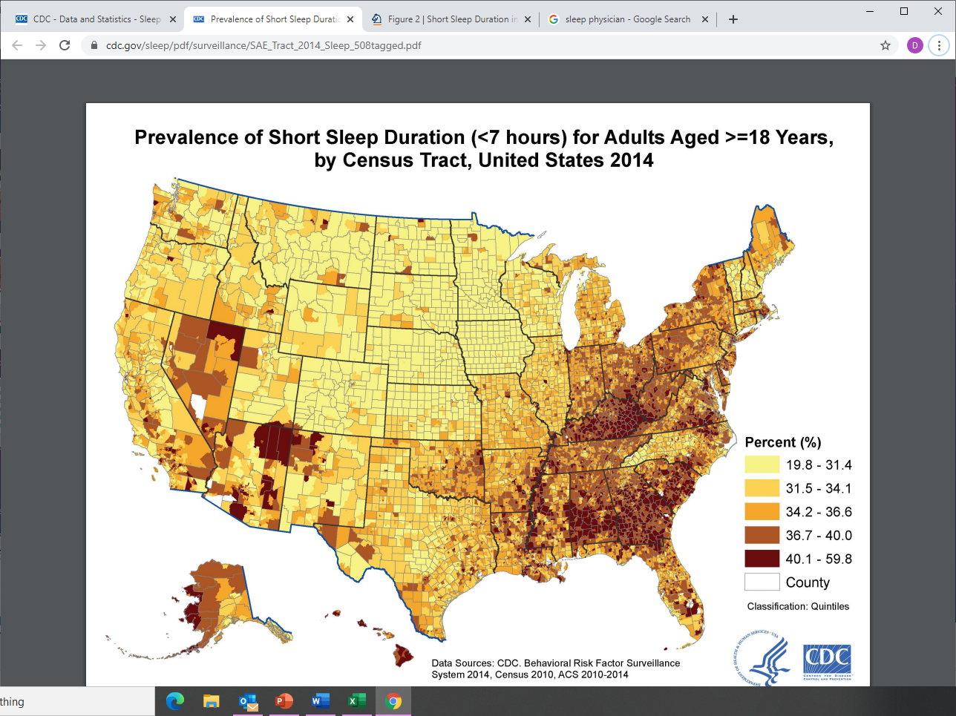
Short Sleep Duration (< 7 hours) in US Adults: Who and Where?
Percent (%)
https://www.cdc.gov/sleep/data_statistics.html
(Behavioral Risk Factor Surveillance System)

Slide 11
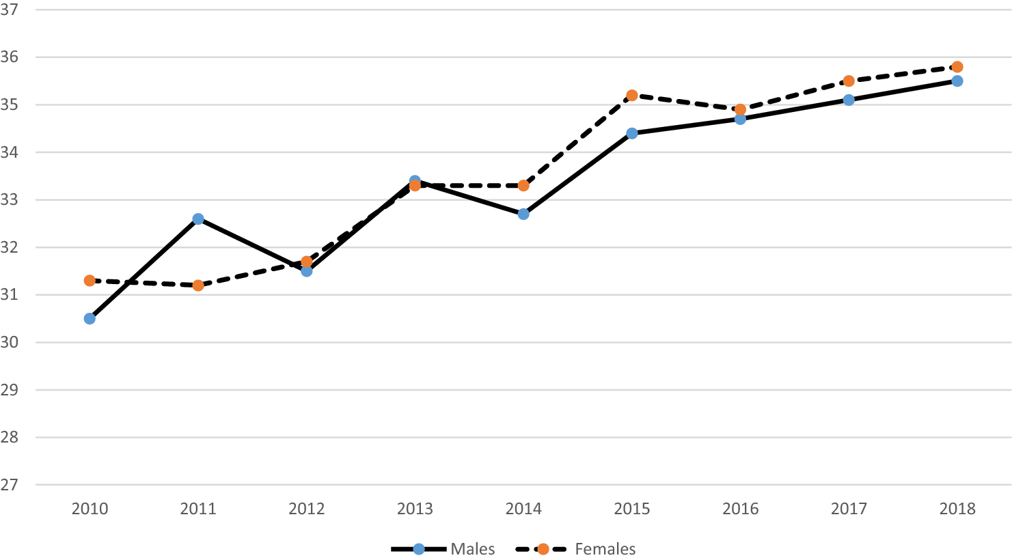
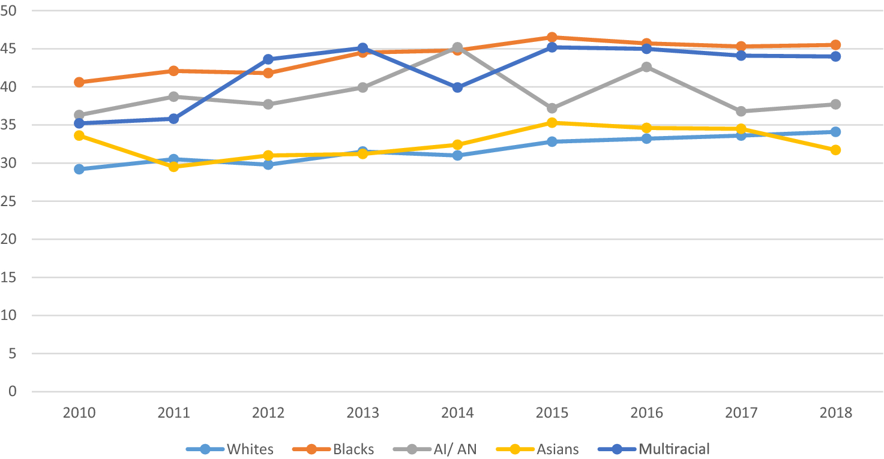
Trends In Short Sleep Duration (≤ 6 h) In Working Adults in the United States (National Health Interview Study)
Khubchandani J and Price JH. J Comm Health 2020
Notes:
National Health Interview Study n . 20,000 households annually

Slide 12
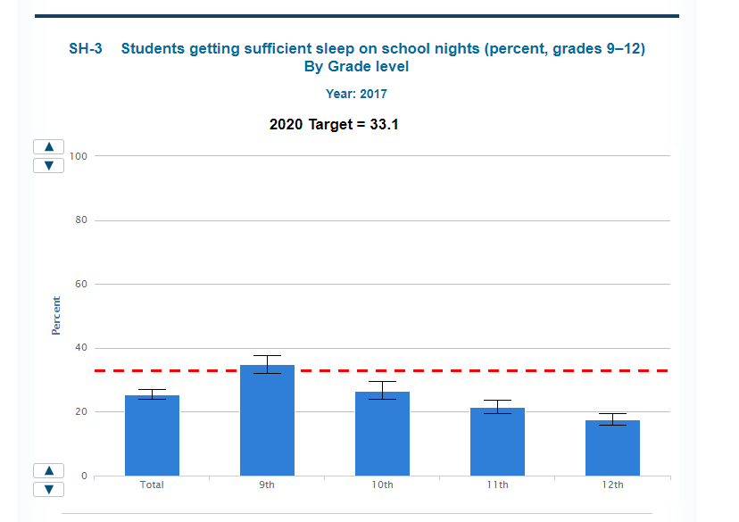
≥ 8 hr. per night
82% of 12th graders do NOT get sufficient sleep

Slide 13

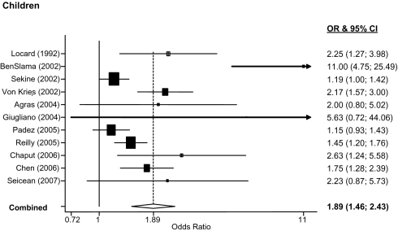
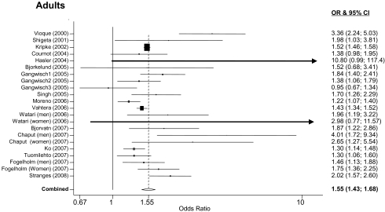
short sleep duration and obesity n=30,002 children and 604,509 adults.
Cappuccio et al. Sleep. 2008 May 1; 31(5): 619–626. doi: 10.1093/sleep/31.5.619
β = -0.35 (-0.57 to -0.12) ∆ BMI /hr. sleep ∆
Notes:
Large n from around world. Is cross sectional so cannot prove causality.

Slide 14
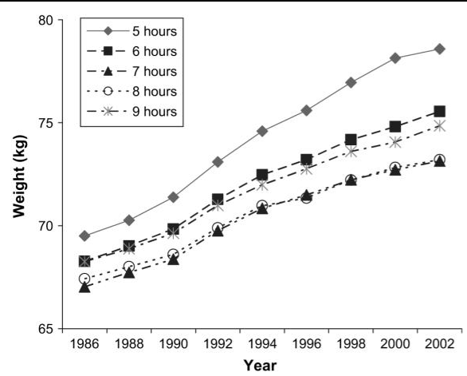
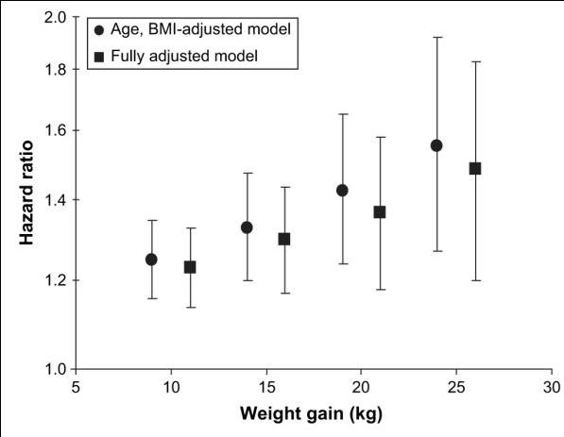
sleep duration, weight gain and risk significant weight gain over 16 years – Prospective Analysis.
68,183 Women In Nurse’s Health Study. Patel SJ et a. Am J Epi 2006;164:947-954
5
6
9
8/7
Notes:
Hazard Ratio

Slide 15
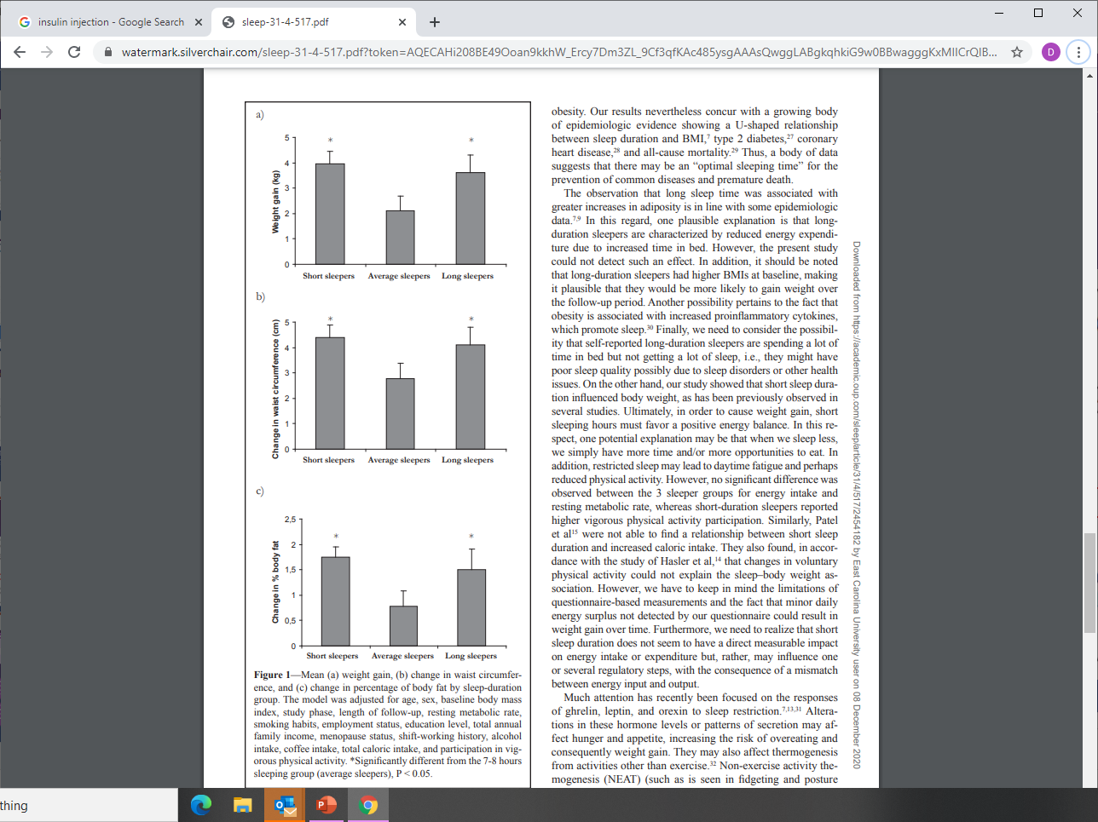
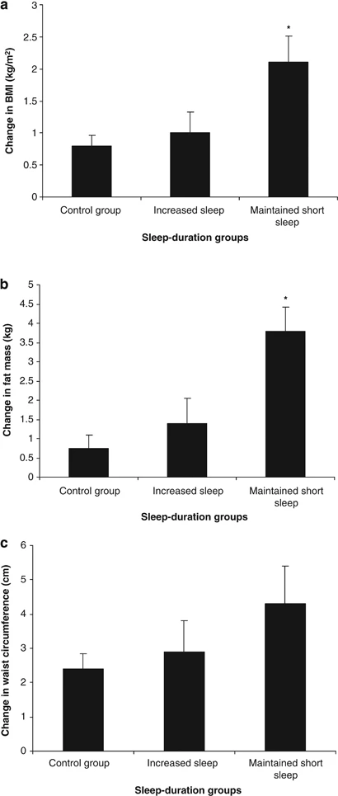
Also prospective…
Chaput J-P et al Sleep 2008;31:517-523
∆ +4.0 lb. ∆ +3.3 lb.
Short sleep at baseline associated with increased weight status after 6 years follow-up
Improving sleep duration after baseline mitigates weight gain after 6 years follow-up
5-6 h. 7-8 h. 9-10 h.

Slide 16

Sleep duration and energy intake
Reduced sleep duration associated with:
  Increased intake high fat/sugar foods in children
  Higher total fat intake in adolescent girls
  Increased % calories from fat/snacks in adults
  Increase alcohol consumption in adults
  Increased caloric intake in sleep reduction studies
  Weight loss non-responsiveness in obese adolescent girls in residential treatment program
Interventions that increase sleep duration associated with:
  Lower caloric consumption in obese children in a weight loss program
  Decreased overall appetite and desire for salty and sweet food in obese adults
  Significantly improved weight loss in obese adults in intervention program with sleep management component
Potential mechanisms:
  Reduced leptin levels: increased appetite and decreased metabolic rate
  Increased ghrelin levels: enhanced feelings of hunger
  Results mixed

Slide 17
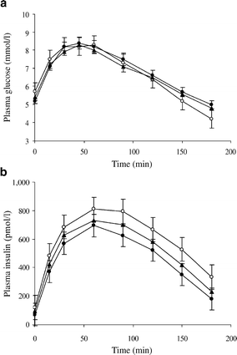
Sleep duration, Glucose Tolerance and diabetes
N= 740 Adults J-P Chaput et al. Diabetologia 2007;50:2298-2304
104.6 mg/dL
75.6 mg/dL
Slow clearance of excess insulin results in relative hypoglycemia
Short sleepers are insulin resistant and overproduce insulin
Sleep Time (h) | OR T2DM or IGT
5-6 | 2.09 (1.34-2.98)
7-8 | 1.00
9-10 | 1.58 (1.13-2.31)
Notes:
Data for men shown

Slide 18
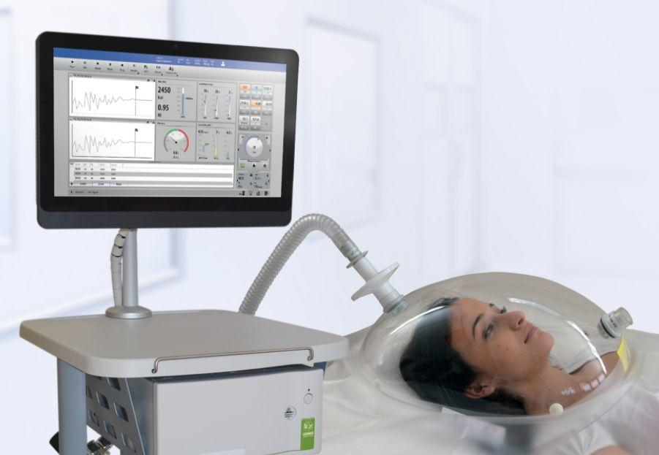
Sleep duration and energy expenditure
Short sleep duration:
  Leads to increased sedentary activity in children
  Is not associated with physical activity in women
  Is associated with reduced vigorous activity in adults
  Is associated with either decreased vs. no effect on resting metabolic rate (RMR)
  Is generally not associated with total energy expenditure (TEE)
  More and better research needed
  Conclude: “ reduced energy expenditure may not be a major contributor to the association between short sleep duration and increased weight status” (Golem DL 2014)

Slide 19
Summary so far
Inadequate sleep duration and/or poor sleep quality is common
Improper sleep duration associated with multiple health risks
Cross sectional, prospective, interventional and experimental evidence all demonstrate a “U” shaped relationship between obesity and sleep duration
Inadequate sleep “causes” obesity largely through caloric intake
Addressing sleep health is a key component of weight management and health promotion

Slide 20
Suggested sleep health questions to include in assessments
Sample questions | Desired answers/targeted behavior
What time do you go to bed every night and wake up every morning? | Consistent bed and wakeup times – even on weekends.
How many hours do you sleep on an average night? | Between 7-9 hours of actual sleep.
Do you have difficulty falling asleep once in bed? | Sleep onset within about 30 minutes.
How many times do you wake each night? | Rarely or only once.
Do you have to get up at night and urinate? If so, how many times? Ever have trouble waking up in time and accidently wetting the bed? | Rarely or just once. No problems with bed wetting.
Do you feel refreshed when you wake up in the morning? | Awaken fresh or with only minimal temporary grogginess.
How often do you feel sleepy during the day? | Rarely.
Do you have problems paying attention or staying awake in class? | No or only occasionally.

Slide 21
Promoting sleep health
Address sleep hygiene: behaviors and practices that enhance sleep duration and quality
  Preparing for sleep – no caffeine, dim lights, calming activities, regular bed/wake time, dark, quiet
  Engaging in physical activity – encourage walking activities to sedentary individuals
    Employ Physical Activity Readiness Questionnaire prior to making other PA recommendations
  Massage therapy – 3 minutes increased sleep duration 46 minutes in nursing home residents
  Daytime napping – 10-30 min naps more effective than caffeine/extended a.m. sleeping in insufficient sleepers
Determine if referral to a sleep specialist is required
  Insomnia, sleep-related breathing disorders (apnea/hypopnea), hypersomnia, shift-work sleep d/o, parasomnias (bruxism, nocturnal enuresis) sleep related movement d/o (PLMS, RLS etc.)
    American Association of Sleep Medicine-accredited sleep center (55 within 100 miles of Greenville!)

Slide 22
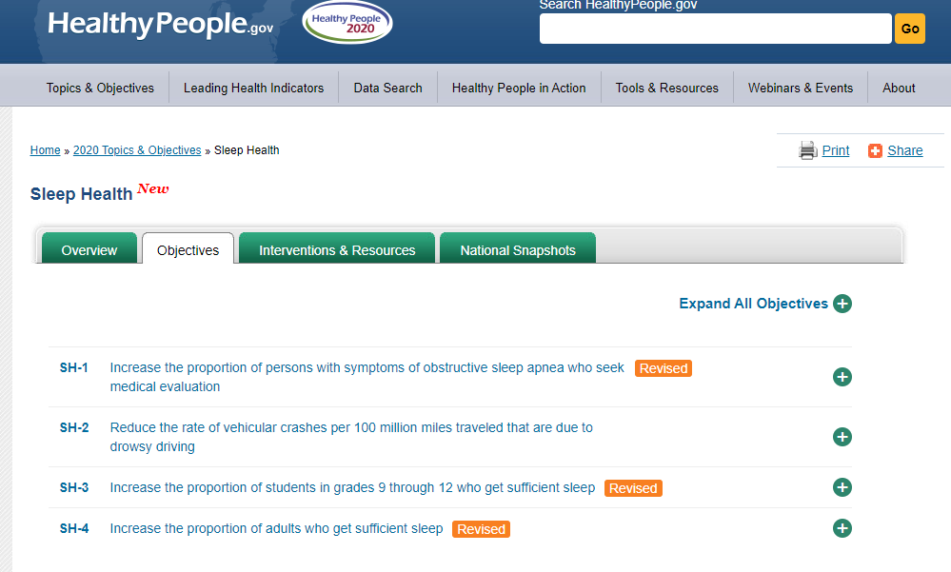
25.6% baseline; target 27.8%
2.7 baseline; target 2.1 VC/100,000,000 miles
30.9% baseline; target 33.1%
71.6% baseline; target 72.8%

Slide 23
Poll Question
Which of the Core Behaviors in the State Plan do you include in your work?
Notes:
Joanne:
STOPS recording.
While the presentation today focused on one of Core Behaviors in North Carolina’s Plan to Address Overweight and Obesity, we’d like to encourage you to use the breakout room discussion to share with and support each other around any of the eight Core Behaviors in the plan. Jenni is chatting a link to access the State Plan.
Let’s get a sense of which Core Behaviors are most relevant to all of you through a poll.
Launch poll …
Reflect on the poll results …
Jenni:
Information about the Core Behaviors in the State Plan can be found here - https://www.eatsmartmovemorenc.com/myesmm/myesmm-core-behaviors/

Slide 24
Networking and Collaborative Learning:
Sleep and Other Core Behaviors
Breakout Discussions
Guidance:
Download the notetaking file from the chat box.
Once you are in breakout rooms, identify a notetaker and facilitator.
Spend 15 minutes discussing:
  What stood out for you about today’s presentation?
  How do or can you address sleep as a core health behavior in your work?
  What needs do you have in order to address sleep or any of the other core behaviors in the Plan?
  What related resources can you share to help other Eat Smart, Move More NC partners?
A pop-up message will appear on your screen – click on it to enter your breakout room.
Notes:
Joanne:
Gives guidance to participants about the breakout room discussions:
We will randomly divide into breakout rooms with about 6 participants each.
Look in the chat box now and download the Word document that Jenni has uploaded. We ask that one person in each breakout room volunteer to capture key points in this template that you will send to us after today’s meeting.
We’ll spend 15 minutes engaging in smaller group discussions about how the Core Behaviors in the Plan play a role in your work and needs you may have, and sharing relevant resources. Notes that the questions on the screen and notetaking template are meant to be conversation starters – your group can determine where you want to focus your discussions.
We’ll reconvene at 1:45 pm and ask some of you to share highlights from your respective breakout discussions.
When we’re ready to open the breakout rooms, a pop-up message will appear on your screen – just click on it to enter your breakout room.
Once we are in breakout rooms, identify a notetaker and a facilitator to keep the conversations flowing and manage the time.
Opens breakout rooms, watches time.
Jenni:
UPLOADS notetaking template

Slide 25
Eat Smart, Move More NC Updates
2021 Executive Committee members
Subcommittees
  Communications
  Partner Meetings
  Partner Engagement
  Executive Committee Leadership
2021 Eat Smart, Move More NC Partner meetings – virtual!
Notes:
Joanne:
The Executive Committee has important updates to share in three areas.
First, I’m pleased and appreciative to announce that not only will all of your current Eat Smart, Move More NC Executive Committee members continue their terms into the next year – we are also excited to welcome three new members.
Reverend Dawn Daly-Mack, who is a Registered Nurse and works as an ACO Care Coordinator for Rural Health Group in northeastern North Carolina.
Breyana Davis, who serves as the Food and Built Environments Extension Association for Steps to Health, NC State’s SNAP-Ed grant.
Dr. Tekeela Green, who is an Adjunct Assistant Professor at Fayetteville State University.
Gretchen Hofing, who serves as the Healthy Eating Coordinator with the Community and Clinical Connections for Prevention and Health Branch with our State Division of Public Health
We’ll post their bios on the Eat Smart, Move More website soon – but a reminder that you can learn more about your current Executive Committee members by visiting the website.
Your Executive Committee has been engaged in thoughtful and strategic discussions over the past month about ensuring that the Eat Smart, Move More NC movement continues to thrive in sustainable ways. We are launching a subcommittee structure for two key purposes: One, to engage more of you – our partners – in guiding and implementing the various activities of Eat Smart, Move More NC; Second, to ensure that we are truly a partner-led and partner-driven movement, supported by various partners and organizations.
On the screen, you see the areas of focus for the subcommittees. While details about specific activities are to be determined, if you’re generally interested in becoming more involved through the subcommittees and helping sustain the movement, please send an email to our info@ account.
The final update I want to share is that we plan to host the Eat Smart, Move More NC Partner meetings virtually through the 2021 calendar year. While we remain hopeful to be able to see you all in person sooner, we also want to be mindful that as restrictions may ease in the next year, that everyone will be focusing on managing transitions professionally and personally. Our hope is that by hosting our meetings virtually, more partners will be able to stay connected with us.
Jenni:
CHATS: Learn more about your Executive Committee members - https://www.eatsmartmovemorenc.com/executive-committee/
CHATS: Let us know if you’re interested in becoming more involved by joining a subcommittee! Send an email to info@eatsmartmovemorenc.com

Slide 26
THANK YOU !
Before you leave today’s meeting,
click on the link in the chat box and complete the feedback survey.
Notes:
Joanne:
Thanks attendees and asks them to share their feedback about the meeting by completing a brief online survey.
Closes the session.
Jenni:
CHATS: Share your feedback about our meetings by completing a brief online survey – https://www.surveymonkey.com/r/eemmnc

