Slide 1
North Carolina's Plan to Address Obesity: Healthy Weight and Healthy Communities 2013-2020
Notes:
.

Slide 2
Public Release January 24th!
Notes:
The purpose of this presentation is to share information with you about the upcoming release of North Carolina’s new Obesity Prevention Plan titled North Carolina's Plan to Address Obesity: Healthy Weight and Healthy Communities 2013-2020 will be released on January 24th.

Slide 3
Objectives
Understand North Carolina's Plan to Address Obesity: Healthy Weight and Healthy Communities, 2013-2020.
Learn ways to promote the release of the Plan in your community.
Understand how to use the Plan to support your obesity prevention efforts.
Notes:
During the presentation, you will learn how the Obesity Prevention Plan was created and the information that is included in the Plan. You will learn about the public release of the Plan and how to support the release of the Plan in your community. We will also discuss how you can use the release of the Plan to support your obesity prevention efforts.

Slide 4
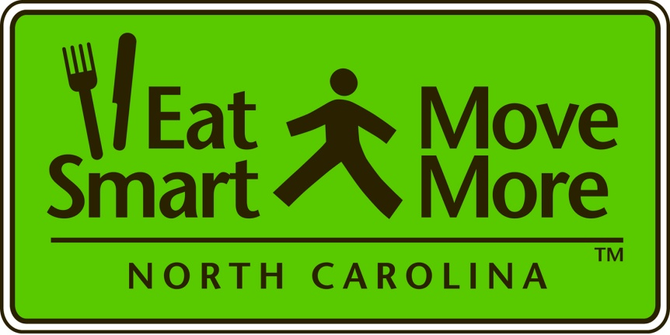
Eat Smart, Move More North Carolina Movement
Eat Smart, Move More North Carolina is a statewide movement that promotes increased opportunities for healthy eating and physical activity wherever people live, learn, earn, play and pray.
Notes:
Let’s start with some background. The Eat Smart, Move More North Carolina is a movement across our state to help people eat smart and move more wherever they live, learn, earn, play and pray. Anyone who works to make healthy eating and physical activity the easy choice for North Carolinians is considered part of this movement.

Slide 5
Eat Smart, Move More North Carolina Leadership Team
A partnership of organizations who work to increase opportunities for healthy eating and physical activity – 80+ member organizations
www.EatSmartMoveMoreNC.com
Notes:
The Eat Smart, Move More NC movement is guided by the ESMM NC Leadership Team. The Leadership Team is a partnership of organizations who work to increase opportunities for healthy eating and physical activity. Any organization whose mission aligns with the mission of the Leadership Team is welcome to join. There are currently over 80 partner organization in the Eat Smart, Move More NC movement.
You can learn more about the Eat Smart, Move More NC Leadership Team and movement by visiting the our web site, listed on your screen. If you are interested in becoming a member of the Leadership Team, you can click on the “contact us” page of the web site for more information.

Slide 6
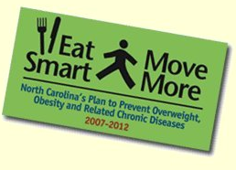
North Carolina’s Obesity Prevention Plan 2007-2012
Eat Smart, Move More: North Carolina’s Plan to Prevent Overweight, Obesity and Related Chronic Diseases,
2007-2012
Notes:
The Eat Smart, Move More NC Leadership Team created and released the first state plan in 2006. It provided a unique opportunity for every organization working in obesity prevention to focus on common goals and objectives, and use the same strategies. This plan guided our efforts for the past five years.

Slide 7
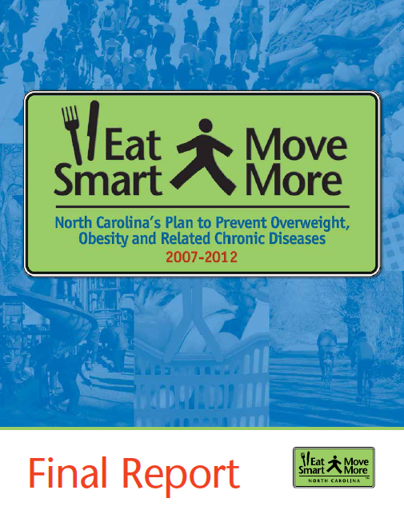
Final Report on North Carolina’s Obesity Prevention Plan 2007-2012
Spring 2013 Release
Notes:
In spring 2013, we will be releasing a final report on the 2007- 2012 Plan. The report will provide an update on the progress that was made on North Carolina’s Obesity Prevention Plan 2007-2012. It will include progress on reaching the goals and objectives of the Plan, as well as stories from communities across the state that have put the Plan’s strategies into action.

Slide 8
Notes:
The goal when creating this plan was to have one plan that guides the obesity prevention efforts of all professionals across North Carolina. In order to create a Plan that everyone could use, we engaged Leadership Team members in providing feedback throughout the development process.

Slide 9
North Carolina’s Obesity Prevention Plan Development Process
September 2011
On-Line Survey
September 2011 – March 2012
The writing team, planning team and the Executive Committee worked on a draft of the Plan
March 2012
Expert review of a draft of the Plan
June 2012
Statewide review of a draft of the Plan
January 2013
Release of North Carolina’s new Obesity Prevention Plan- January 24th State Health Director’s Conference
Notes:
North Carolina’s Plan to Address Obesity: Healthy Weight and Healthy Communities, 2013-2020 was created under the guidance of the 2011-2012 Eat Smart, Move More NC Executive Committee. The Executive Committee established a writing team and a planning team to oversee the development and review of the Plan. The six member writing team was led by the Past Chair of the Executive Committee. The writing team was responsible for the overall writing and coordination of the Plan development. The planning team consisted of members of the writing team plus seven additional members from the Eat Smart, Move More North Carolina Leadership Team. The planning team guided the development of the Plan and provided feedback on early drafts of the Plan.
The development process began in September 2011 with an on-line survey. One hundred and twenty four professionals from across the state responded to questions about the current obesity prevention plan to inform the development of the new plan. A writing team and planning team composed of representatives from the Eat Smart, Move More NC Leadership Team created a draft plan under the advisement of the Executive Committee that was informed by the survey feedback.
In March, a review of the plan was conducted by technical experts. Overall, the Plan was reviewed by 14 subject matter experts.
In June 2012, we conducted a statewide review of the Plan. An email was sent to all the members of the Eat Smart, Move More NC Leadership with an opportunity to review the document and provide feedback. Over 60 people responded electronically. We also held virtual town hall meetings during this time (webinars) and over 70 people attended.
The plan will be released next week, on January 24th, at the State Health Directors Conference.

Slide 10
The Plan:
aligns with Healthy North Carolina 2020 objectives
is based on the most recent evidence base of what works for obesity prevention
incorporates recommendations from the Eat Smart, Move More NC Policy Strategy Platform (www.EatSmartMoveMoreNC.com)
is based on feedback from professionals across the state collected through the on-line survey, planning team and expert review
Notes:
The plan:
Aligns with Healthy North Carolina 2020 objectives
Is based on the most recent evidence base of what works for obesity prevention
Incorporates recommendations from the Eat Smart, Move More NC Policy Strategy Platform
Is based on feedback from professionals across the state collected through the on-line survey, planning team and expert review

Slide 11
Intended Audience
Professionals working in any of the following settings who want to promote health and prevent obesity:
Health care
Child care
Schools
Colleges and universities
Work sites
Faith-based organizations and other community organizations
Local government
Food and beverage industry
Notes:
The Plan is intended for a broad audience – for professionals working in in any of the following settings who want to promote health and prevent obesity:
Health care
Child care
Schools
Colleges and universities
Work sites
Faith-based organizations and other community organizations
Local government
Food and beverage industry

Slide 12
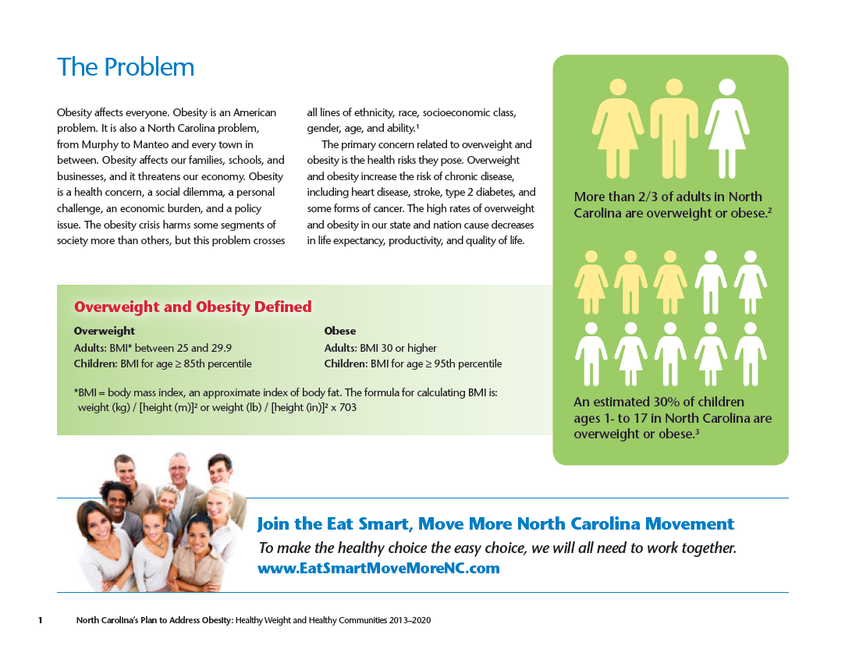
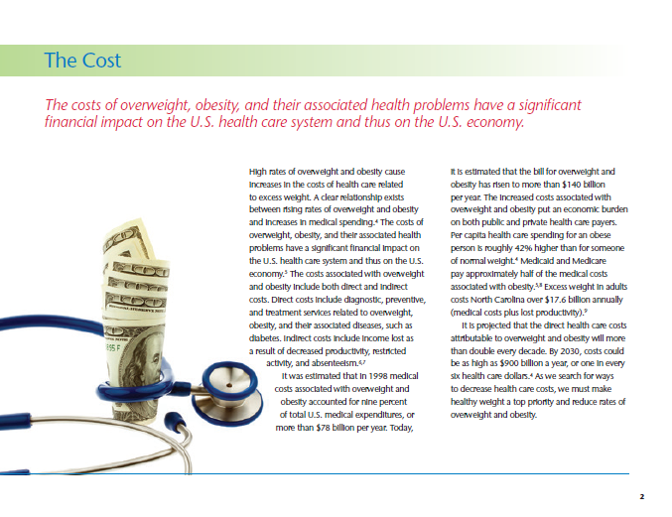
Notes:
The Plan outlines the problem of obesity and the cost.

Slide 13
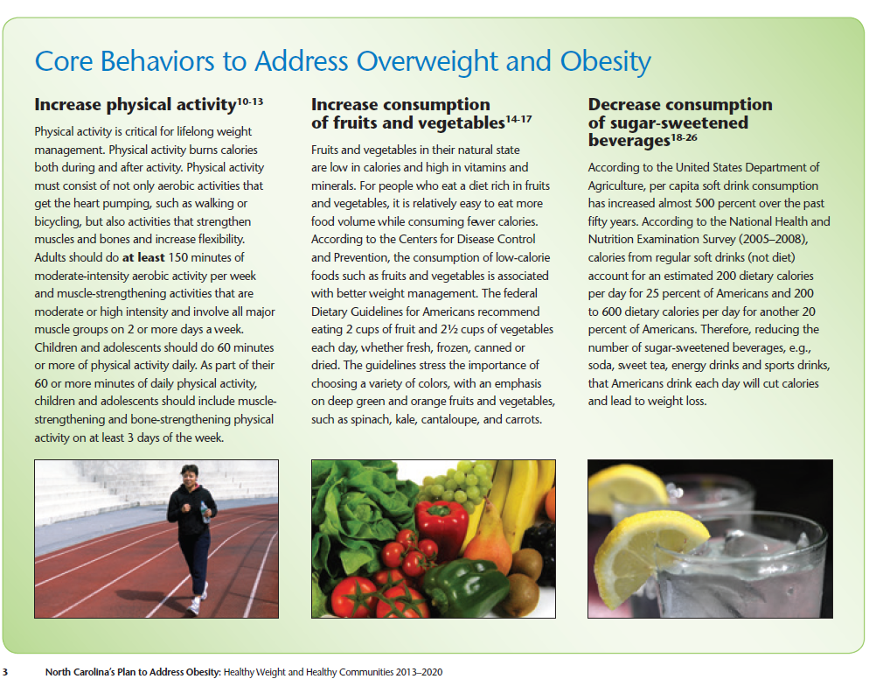
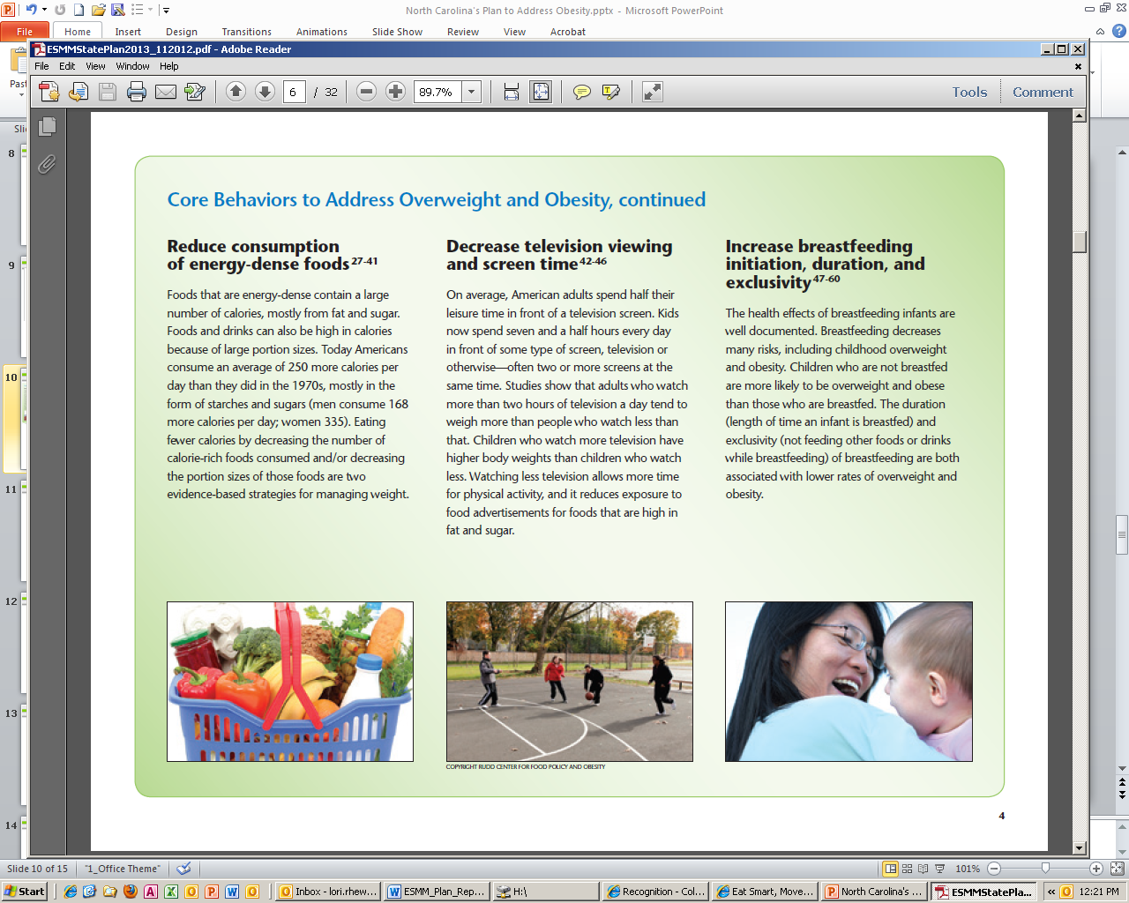
Notes:
It explains the core behaviors for obesity prevention.

Slide 14
Notes:
The Plan uses a new graphic to summarize the change that is needed… a shift from our current environment to one that makes the healthy choice the easy choice.

Slide 15
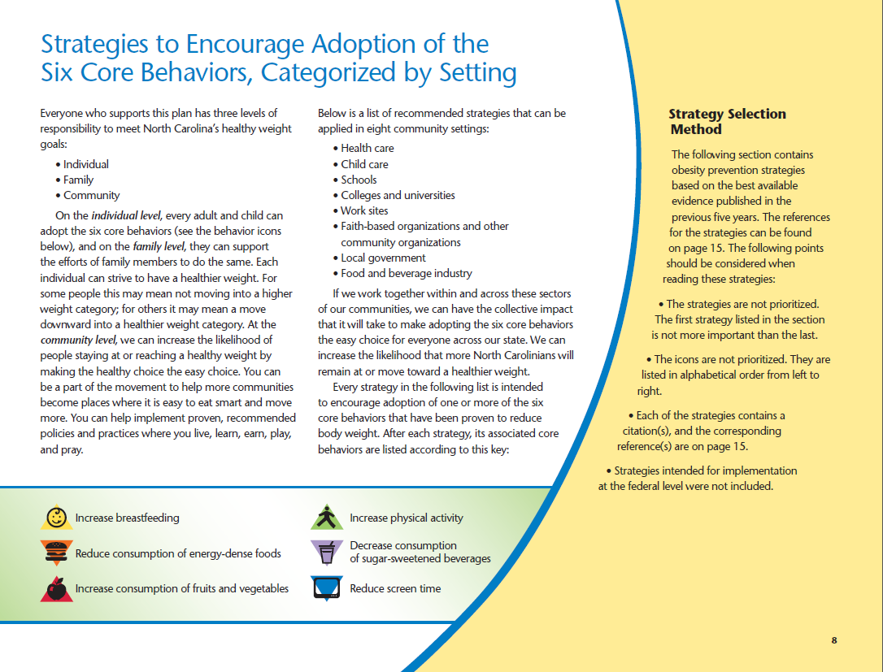
Notes:
The Plan includes obesity prevention strategies, based on the best available evidence, for partners across the state to implement.

Slide 16
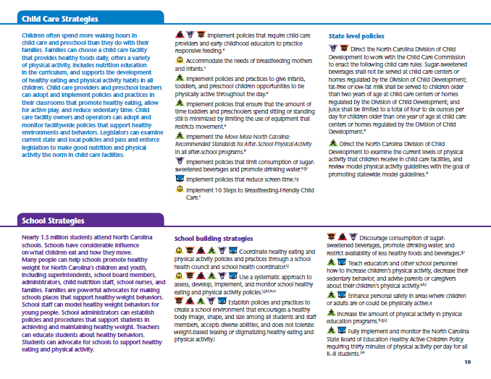
Settings
Health care
Child care
Schools
Colleges and universities
Work sites
Faith-based organizations and other community organizations
Local government
Food and beverage industry
Notes:
The strategies are organized by setting to make it easy for a reader to quickly find those that are more relevant.

Slide 17
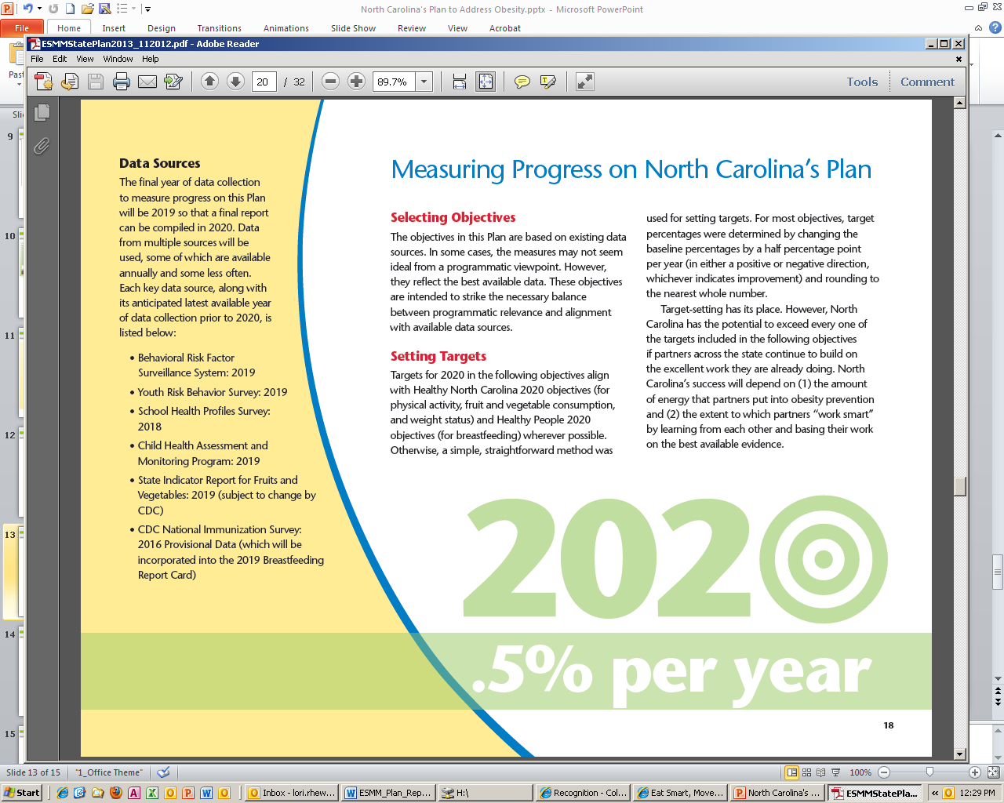
Notes:
The Plan includes specific, measureable objectives on places and practices, healthy behaviors and weight status.

Slide 18
Public Release
January 24, 2013
NC State Health Director’s Conference
Electronic copies of the Plan will be available at:
www.EatSmartMoveMoreNC.com
Notes:
The plan will be publically released on January 24th at the State Health Director’s Conference. There will be a session from 4:00 – 5:00 p.m. at the conference specifically on the Plan. All conference participants will receive a hard copy of the Plan. However, the Plan will be largely web based and will be available on the Eat Smart, Move More NC Web site on January 24th for download. Once you go to the site, you can click on “NC’s Plan” to download the Plan. There is a high and low resolution copy of the Plan on the site. The High resolution can be used for professional copies and the low resolution is printer-friendly.

Slide 19
Public Release
State Health Director’s Conference
Press Release
Health Crisis in Carolina: Real Families, Real Struggles, Real Solutions
UNC-TV Sunday, February 3, 2013 @ 1pm
https://vimeo.com/55640574
Notes:
Aside from the session at the State Health Director’s Conference, we will send out a press release statewide and are promoting a documentary, called Health Crisis in Carolina: Real Families, Real Struggles, Real Solutions.
The documentary highlights the need for making healthy eating and physical activity easier in North Carolina. The documentary air on UNC-TV on Sunday, February 3, 2012 at 1 p.m. The series follows three North Carolina families as they learn about how where they live, learn, work, play and pray has on their lifestyle choices.
To help you learn more about this series, here is a short clip. We will also make this available on the Eat Smart, Move More NC Web site.

Slide 20
Promote the Plan
Share copies of the Plan and information about the Plan with partners who may not be aware of the Plan and how their work aligns with the Plan
Promote the use of the Plan among partners
Notes:
We encourage you to promote the Plan in your community. Share copies of the Plan with partners who may not be aware of the Plan and how their work aligns with it. Encourage them to use the Plan as a guide. As we mentioned earlier, the goal when creating this plan was to have one plan that guides the obesity prevention efforts of all professionals across North Carolina.

Slide 21
Promote the Plan
What can you do?
Link to the Plan on your organization’s/coalition’s Web site.
Send out a press release about the Plan.
Include information about the Plan in newsletters.
Share the Plan on social media.
Promote the Health Crisis in the Carolina documentary in your community.
Notes:
Here are some specific ways to promote the Plan in your community.
Link to the Plan on your organization’s/coalition’s Web site.
Send out a press release about the Plan.
Include information about the Plan in newsletters.
Share the Plan on social media.
Promote the Health Crisis in the Carolina documentary in your community.

Slide 22
Use the Plan
Review the Plan.
Determine what strategies your organization will focus on.
Create a plan for how your organization will work on these strategies.
Communicate this plan.
Monitor and report progress on implementing these strategies.
Notes:
As partners hear about the Plan, it is our hope that they will follow these simple steps. The first step is to determine what strategies from the Plan their organization or coalition will focus on. This might mean scheduling meetings with internal staff or leadership to discuss and make this decision. The next step is to create a plan for how the organization or coalition will work on these strategies. Then comes the important step of communicating this plan to make sure that everyone is on the same page. Finally, we encourage partners to monitor and share their progress on putting the Plan’s strategies into action.

Slide 23
Communicate Success
Share how your work supports the Plan. Share your story in:
Newsletters
Print materials
Social media
Presentations
Conversations
Notes:
Use this as an opportunity to promote, not only the Plan, but the good work that your organizations and your partners are already doing in your community. Share the story of your obesity prevention work and how it supports the Obesity Prevention Plan. Here are some of the ways that you can share your success:
Newsletters
Print materials
Social media
Presentations
Conversations

Slide 24
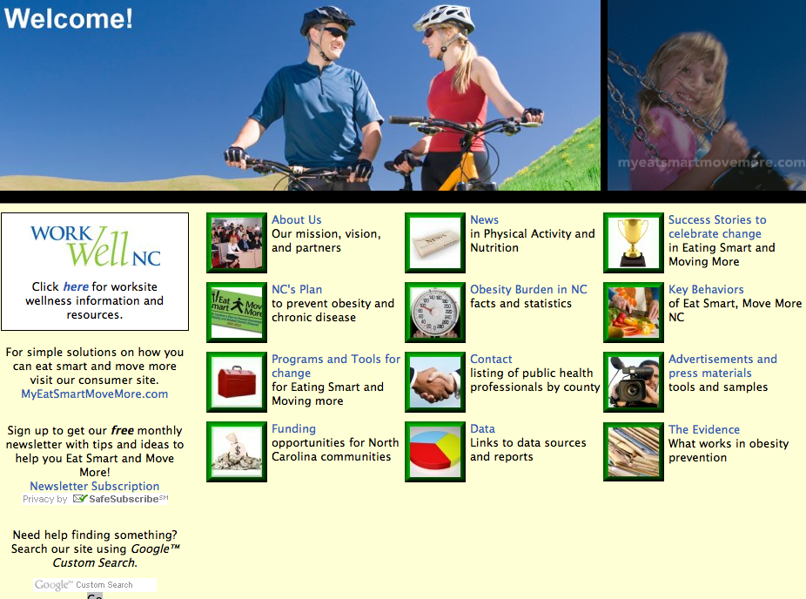
For more information visit:
www.EatSmartMoveMoreNC.com
Notes:
You can learn more about the Eat Smart, Move More NC Movement and Leadership Team at www.EatSmartMoveMoreNC.com.

Slide 25
Questions?

Slide 26
Thank You

