Slide 1
WELCOME !
As you enter today’s meeting, use the chat box to tell us:
Your organization and community.
What has been a bright spot during your week?

Slide 2
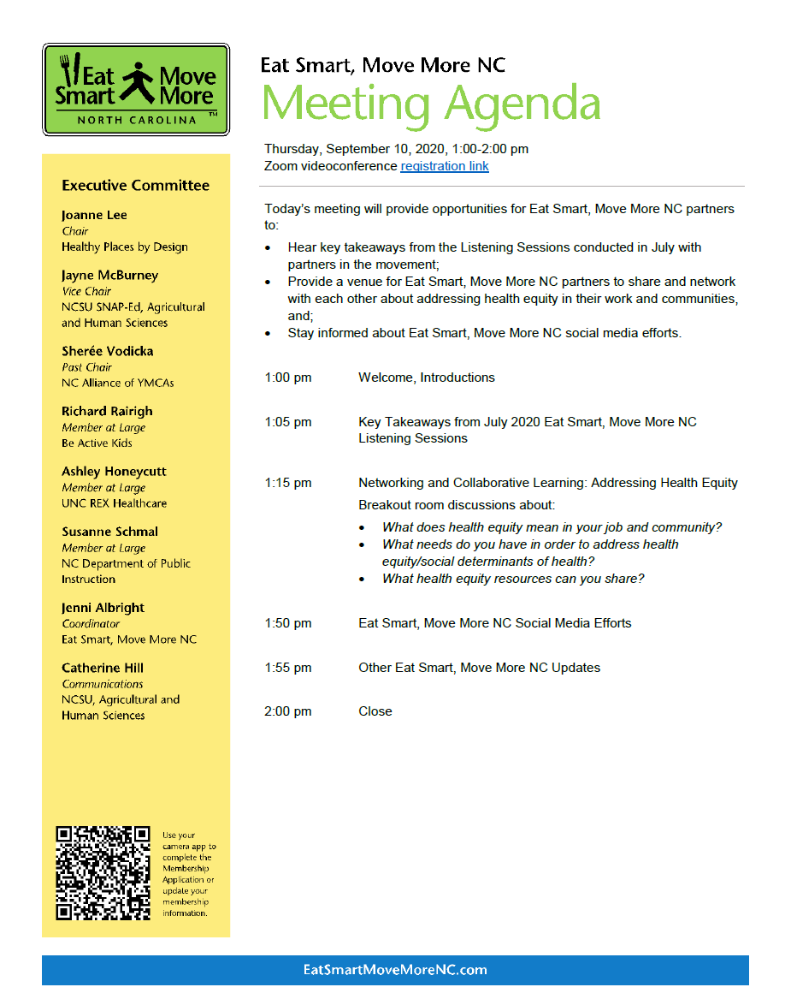

Slide 3
July 2020 Listening Sessions
Two One-hour Sessions
Tuesday, July 14
Thursday, July 23
Objectives
Provide venues for Eat Smart, Move More NC partners to share their experiences and inform future activities for the movement;
Gain understanding of the current health, social, and political environment and landscape in NC communities; and
Obtain input about how Eat Smart, Move More NC can support partners’ efforts.

Slide 4
July 2020 Listening Sessions
Engagement
More than 20 individual partners
Cross-sector representation
public and private sectors
academia, business, early childhood, education, public health, chronic disease and wellness, nutrition, recreation and parks, physical activity

Slide 5
July 2020 Listening Sessions
Key Learnings
Partners/members of the Eat Smart, Move More NC movement have remained resilient amid the COVID-19 crisis, with many increasing services and/or finding new opportunities to meet community needs.
Partners of the movement value the Eat Smart, Move More NC resources.
Partners are interested in learning more from others in the movement.
Addressing social determinants of health and health equity is a priority shared by partners of the movement.

Slide 6
July 2020 Listening Sessions
Moving Forward in 2020
Partner meetings via videoconferences
Shorter, more frequent meetings
Social media for more opportunities to engage and network
2020 Meetings
Thursday, October 22, 1-2 pm
Wednesday, December 9, 1-2 pm

Slide 7
Networking and Collaborative Learning: Addressing Health Equity
Breakout Discussions
Guidance:
Download the notetaking file from the chat box.
Spend 20-25 minutes discussing:
What does health equity mean in your job and community?
What needs do you have around addressing health equity?
What health equity resources can you share?
A pop-up message will appear on your screen – click on it to enter your breakout room.
Once you are in breakout rooms, identify a notetaker and facilitator.

Slide 8
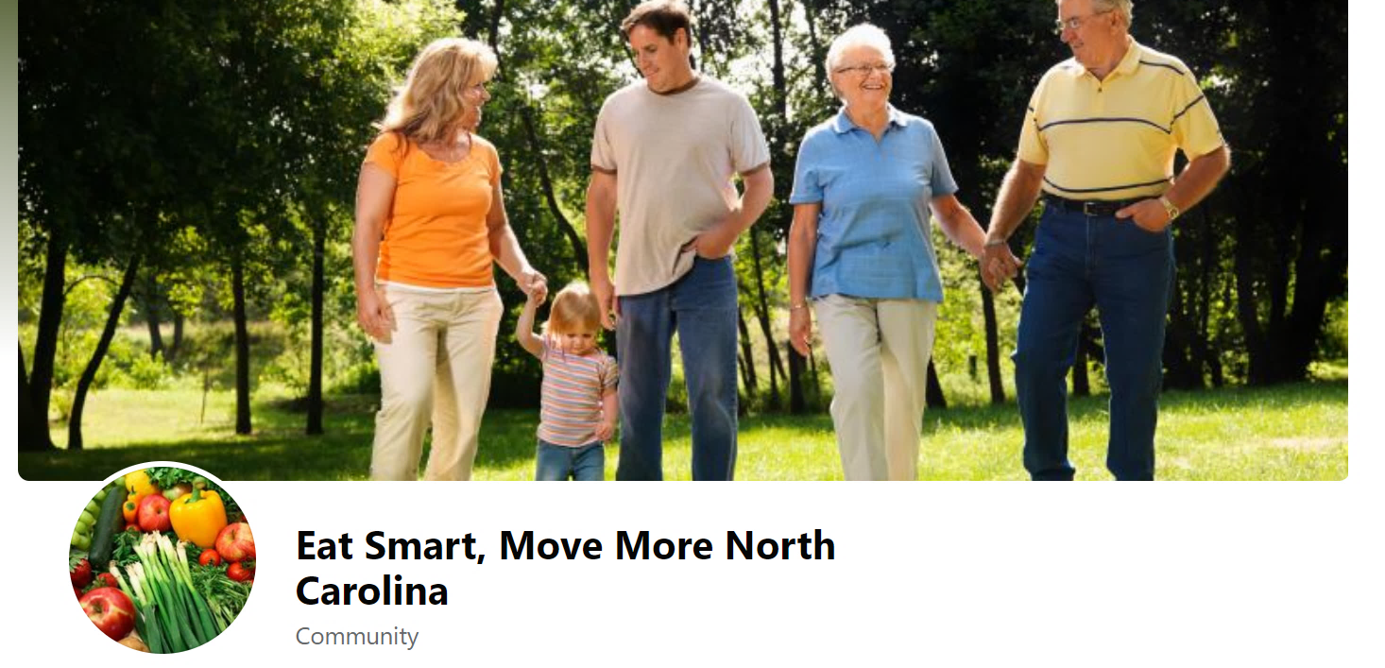
Social Media Update
(Re)Launch September 2020 on Facebook

Slide 9
Purpose of Social Media For ESMM
Reach more professionals and organizations interested in supporting the movement.
Promote the Plan, core behaviors and implementation of strategies within various sectors.
Incorporate a health equity lens into social media efforts.
Connect professionals and share local successes.
Drive people to the ESMM website.

Slide 10
Coming Soon: ESMM on LinkedIn
Be sure to join us for the October 22nd meeting:
To learn more about how to use LinkedIn, in general.
To learn how ESMM will use LinkedIn and connect with organizations.

Slide 11
Questions or Suggestions
Susanne Schmal
Member, Social Media Committee
Susanne.Schmal@dpi.nc.gov

Slide 12
THANK YOU !
Before you leave today’s meeting, click on the two links in the chat box:
Feedback survey
Registration for October 22 Partners Meeting

